Slide 1
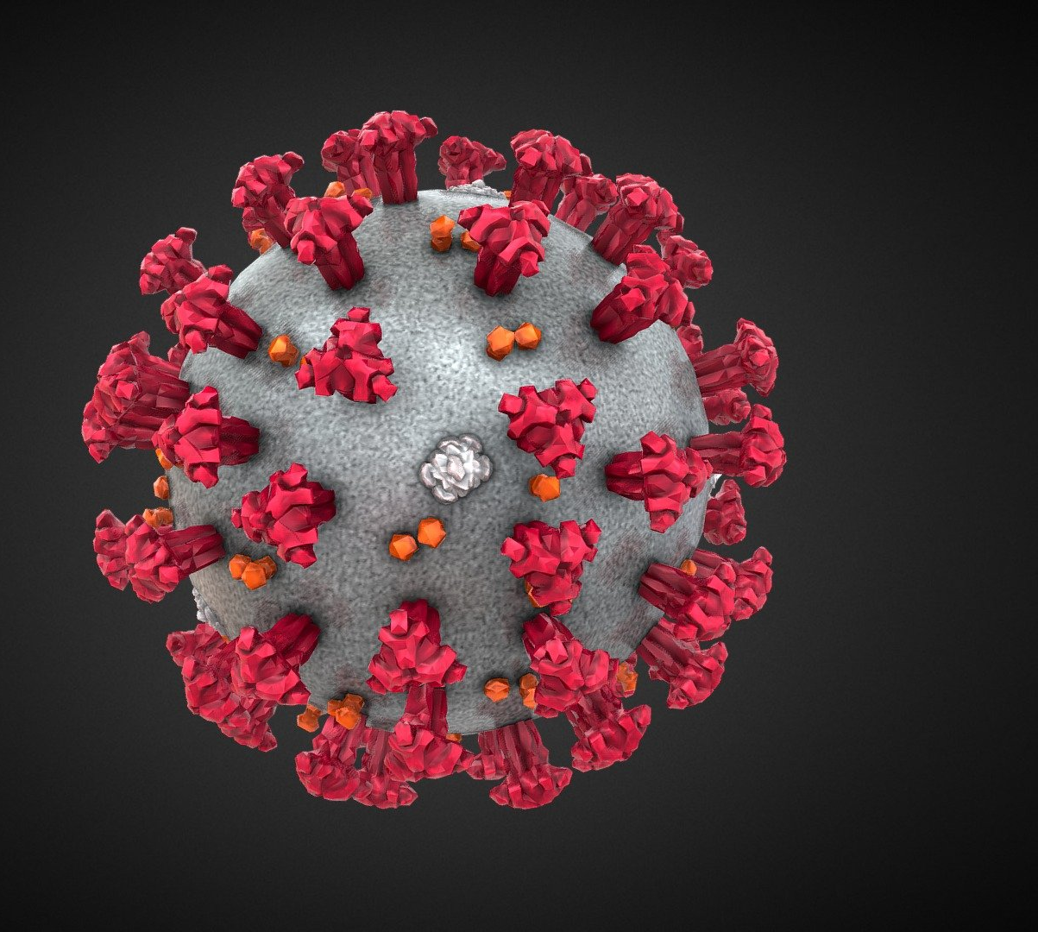
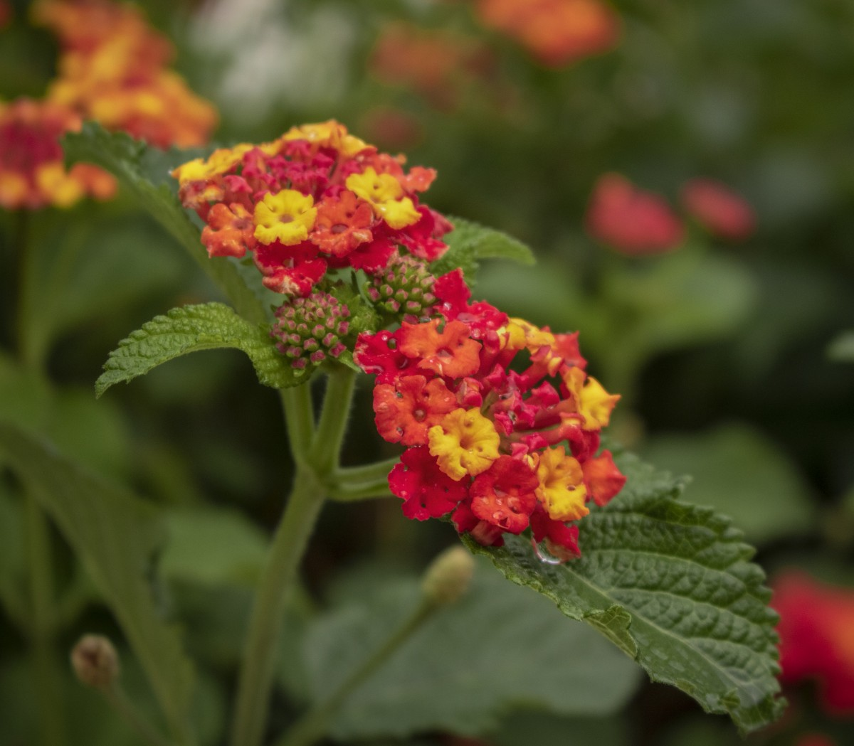
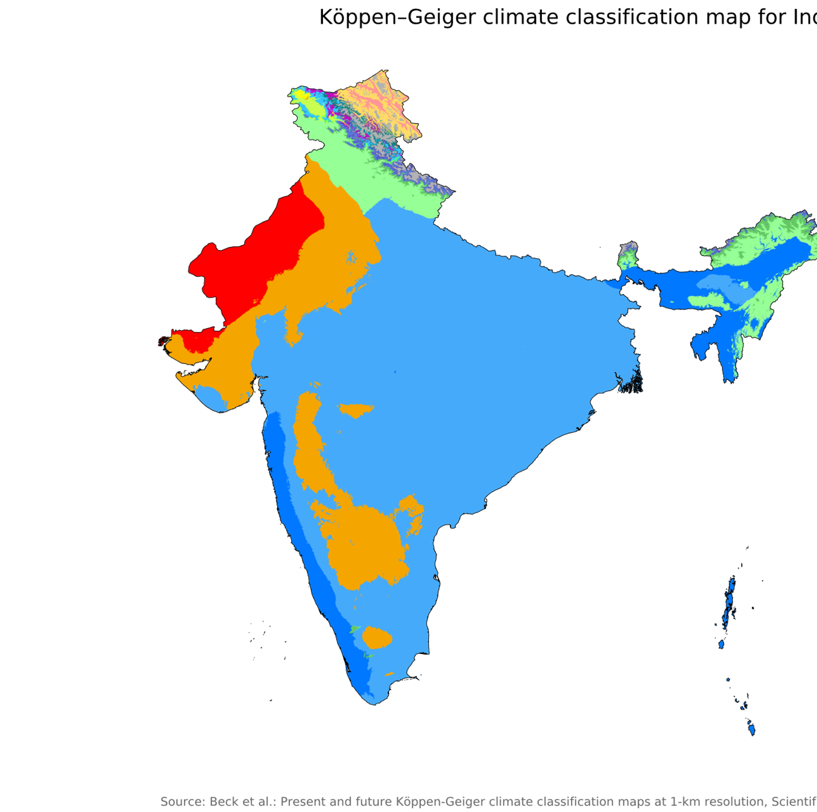
SemanticClimate
Who we are and how we work
Open access and climate justice
Making UN IPCC semantic
Open Access accessible to people and machines
2020
2021
2022
openVirus
Plants
IPCC reports

Slide 2
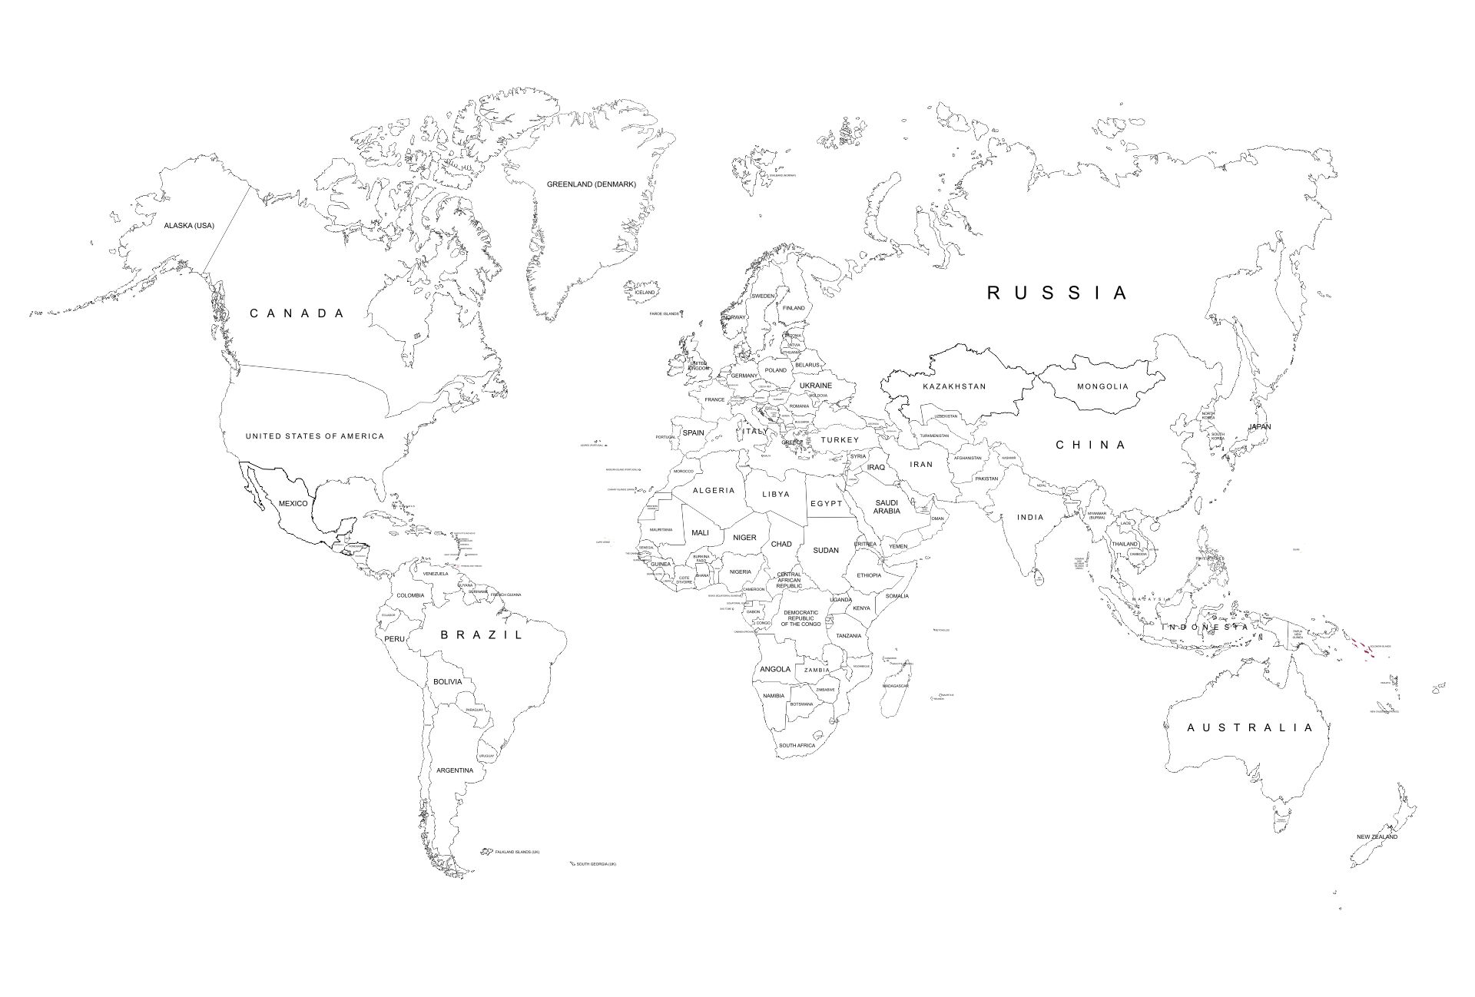

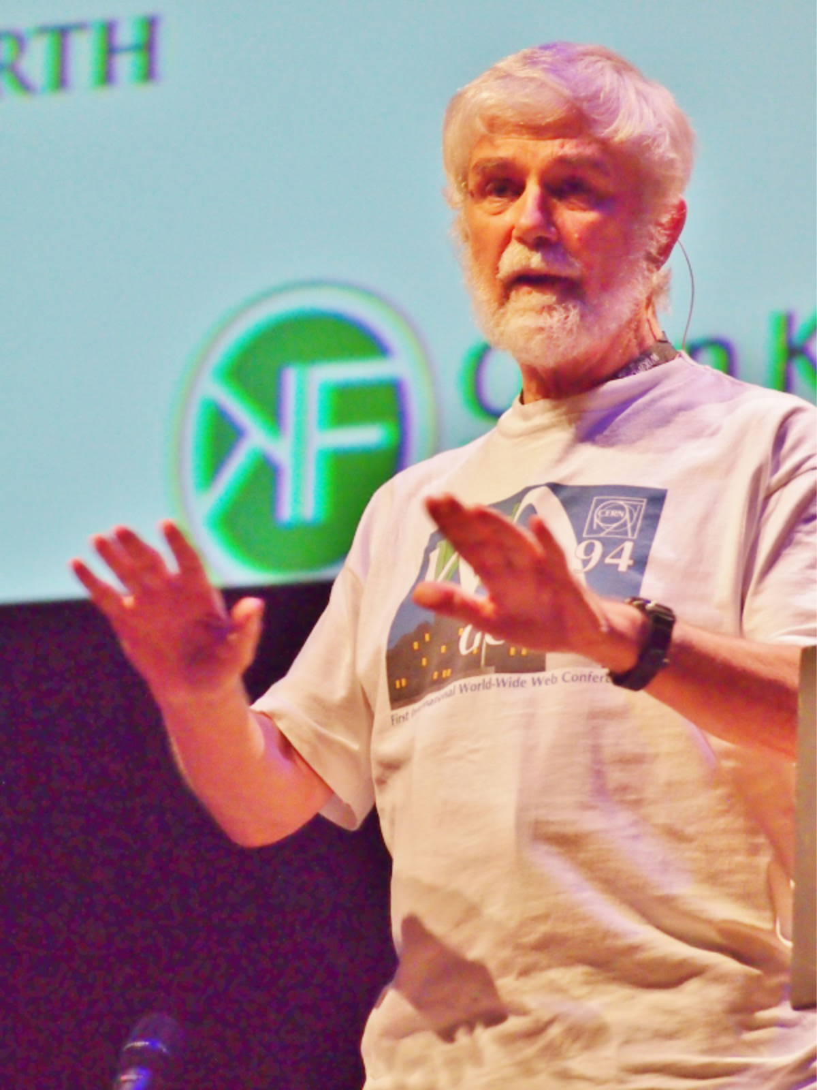

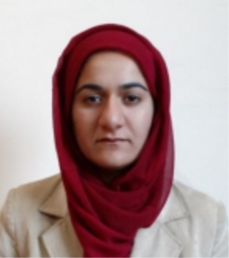
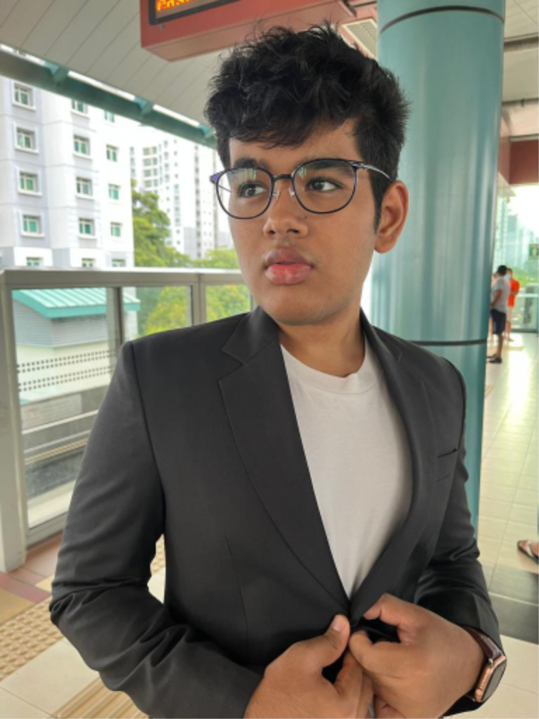
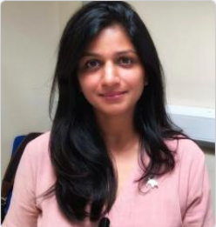

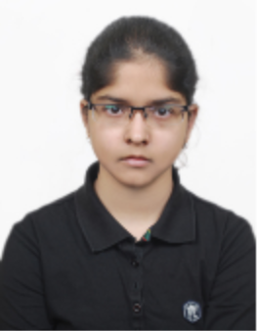

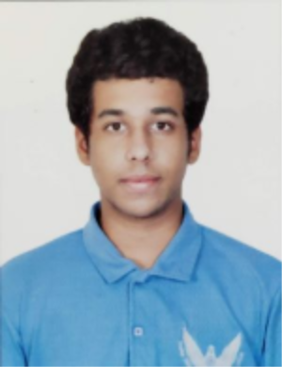

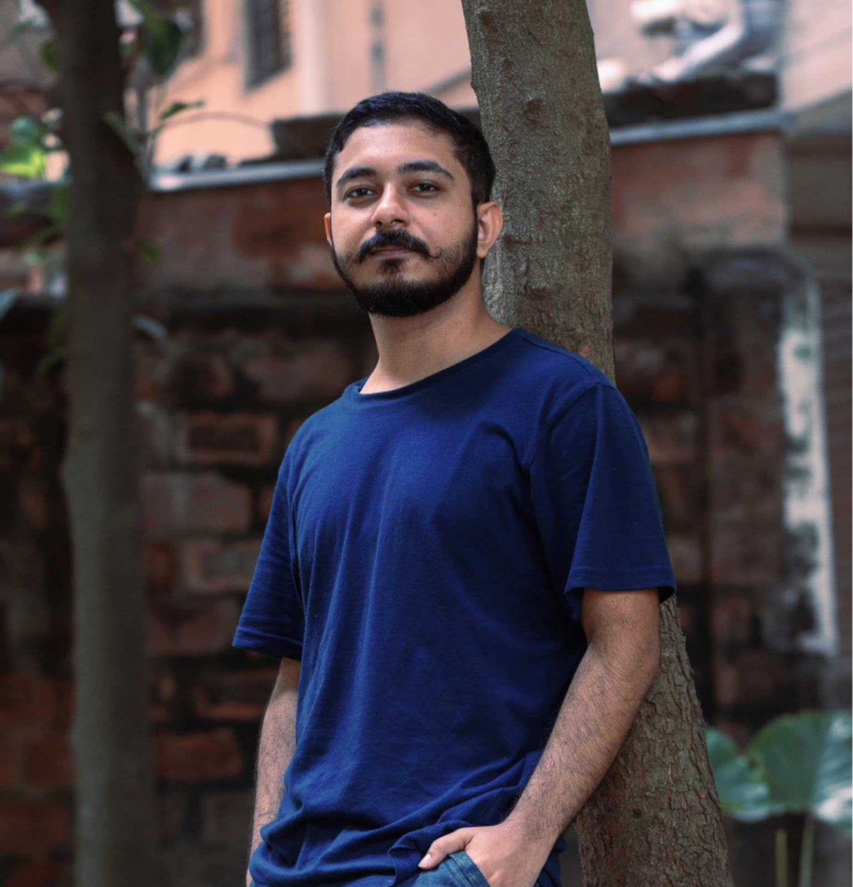
Semantic Climate -- 2022
Simon
Add more people
Slide credit: Enakshi Das

Slide 3
Story
Automate:
Download
Semantify
What is “climate justice”?
Let’s ask the literature!
Value of open: automation -> throughput and immediacy
200 articles in 2 minutes

Slide 4


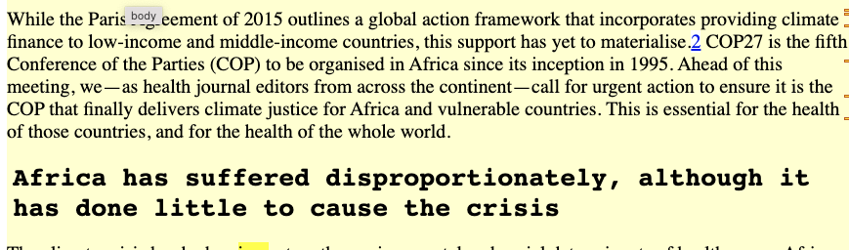
200 papers 2 minuters
Typical article on “climate justice”
fulltext

Slide 5
Workflow
Analyse content
Create Dictionaries
Download Literature
Search with dictionaries
Link to Wikimedia
Shweata N Hegde

Slide 6
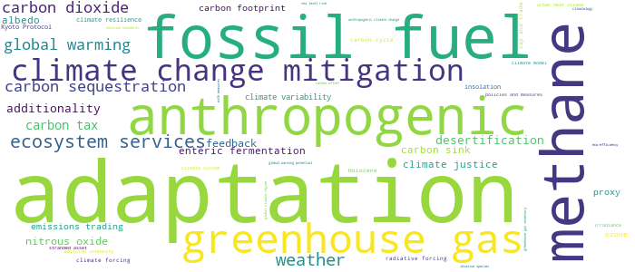
#3 See the big picture using dictionaries!
Demo link
{'adaptation': 286, 'fossil fuel': 111, 'methane': 107, 'anthropogenic': 83, 'greenhouse gas': 81, 'climate change mitigation': 66, 'ecosystem services': 48, 'weather': 44, 'carbon sequestration': 35, 'global warming ': 33, 'carbon dioxide': 33, 'carbon tax': 21, 'desertification’: …}
#SemanticClimate’s Climate Knowledge Hunt
docanalysis
From 6 chapters of IPCC

Slide 7

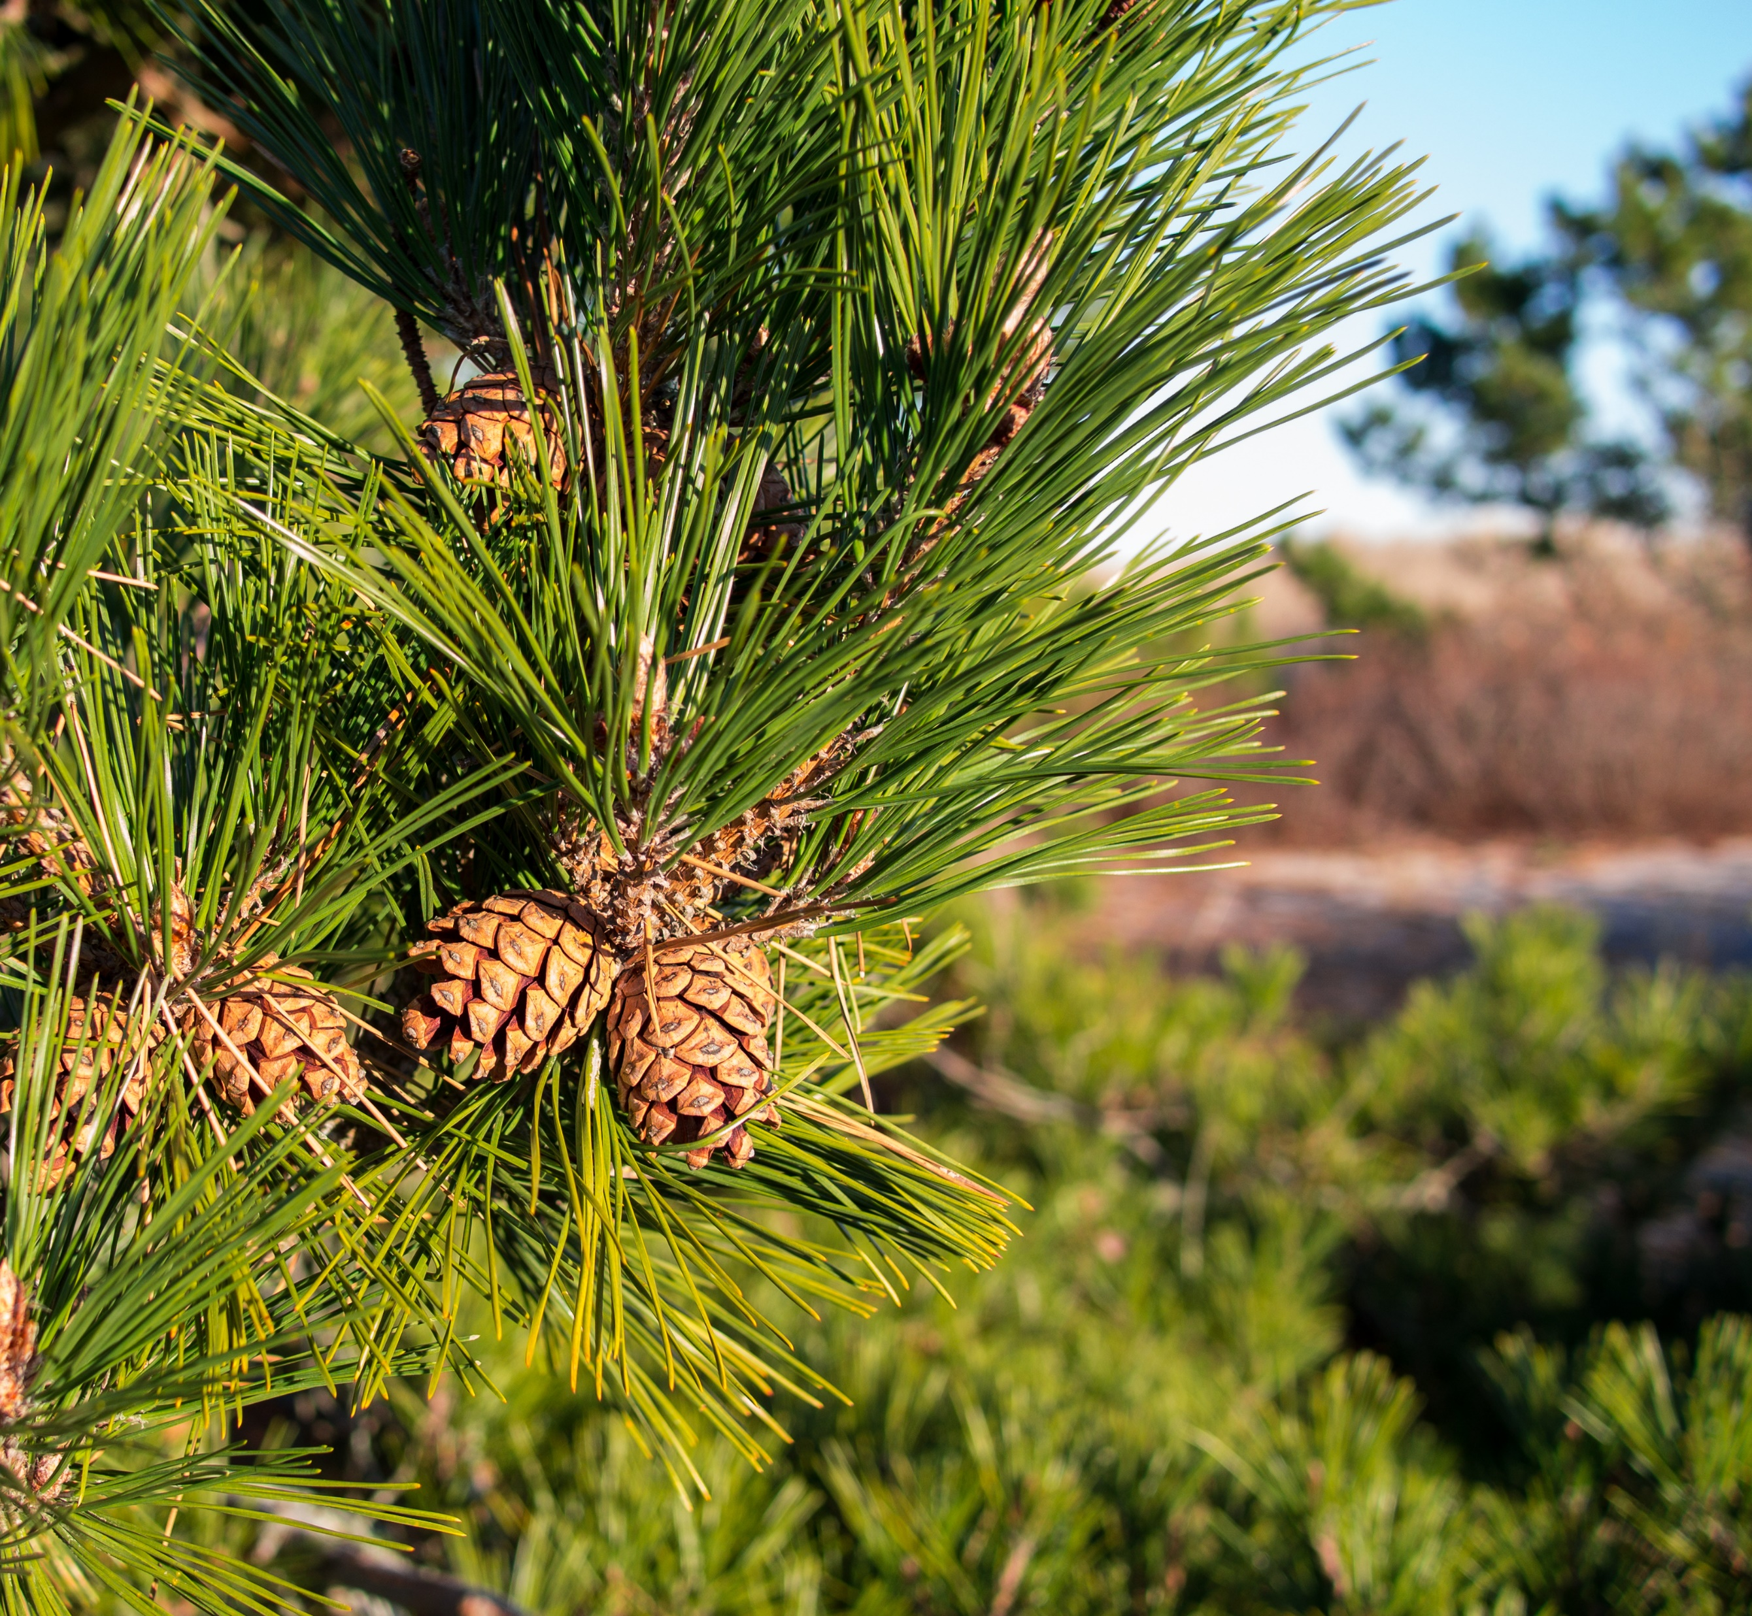
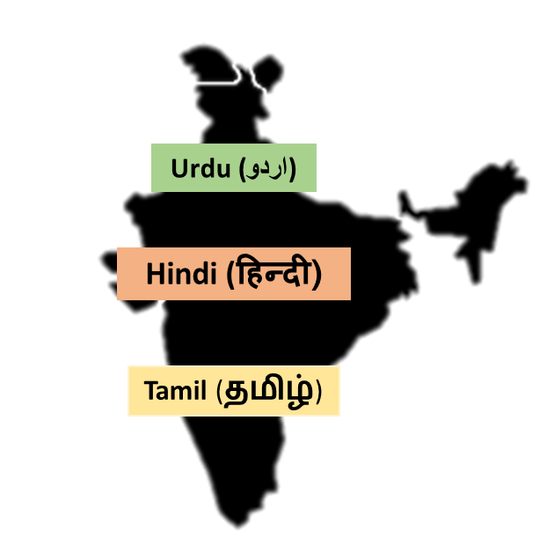


Dictionaries
MULTILINGUAL
Cone
<synonym xml:lang="zh">松球</synonym>
<synonym xml:lang="de">Koniferenzapfen</synonym>
<synonym xml:lang="hi">कोणधारी कोण</synonym>
<synonym xml:lang="es">cono</synonym>
<synonym xml:lang="fr">cône</synonym>
Human understanding
Indexing
Feeds into AI
Plants dictionary
This Photo by Unknown Author is licensed under CC BY-SA
Definitve global dictionary of CC
By Version 1 by Nohat (concept by Paullusmagnus); Wikimedia. - File:Wikipedia-logo.svg as of 14 May 2010T23:16:42, CC BY-SA 3.0, https://en.wikipedia.org/w/index.php?curid=33285413
Slide Credit: Ambreen Hamadani
Notes:
Wikidata and Wikipedia globe
Slide for minicopus
Make it clearer __ explain well
Explain zoonosis
Dictionaries are often called ontology
Critical for annotations and Ontology
Ontology

Slide 8

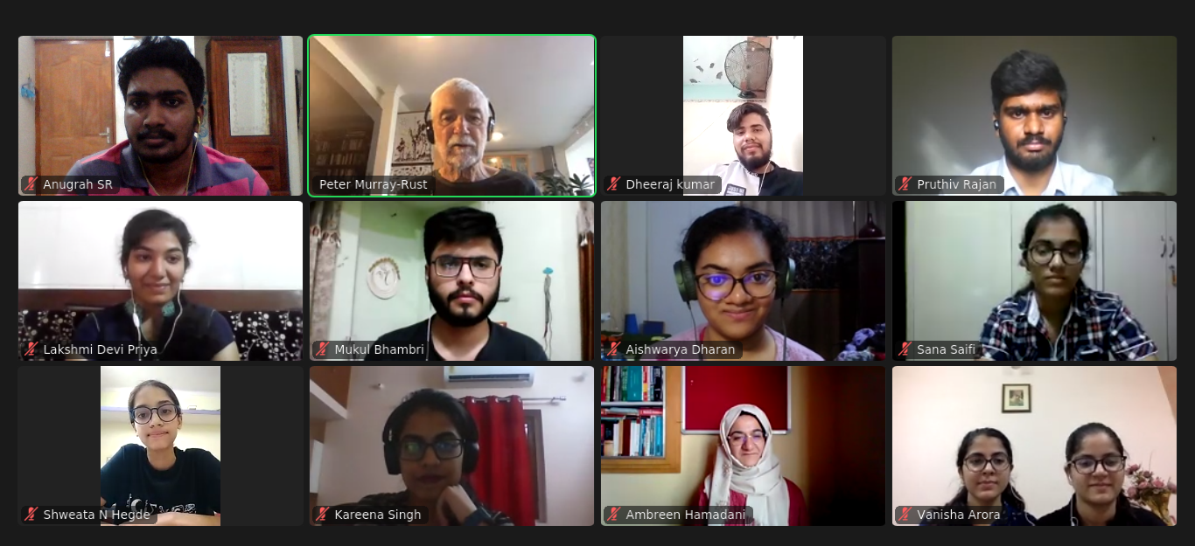
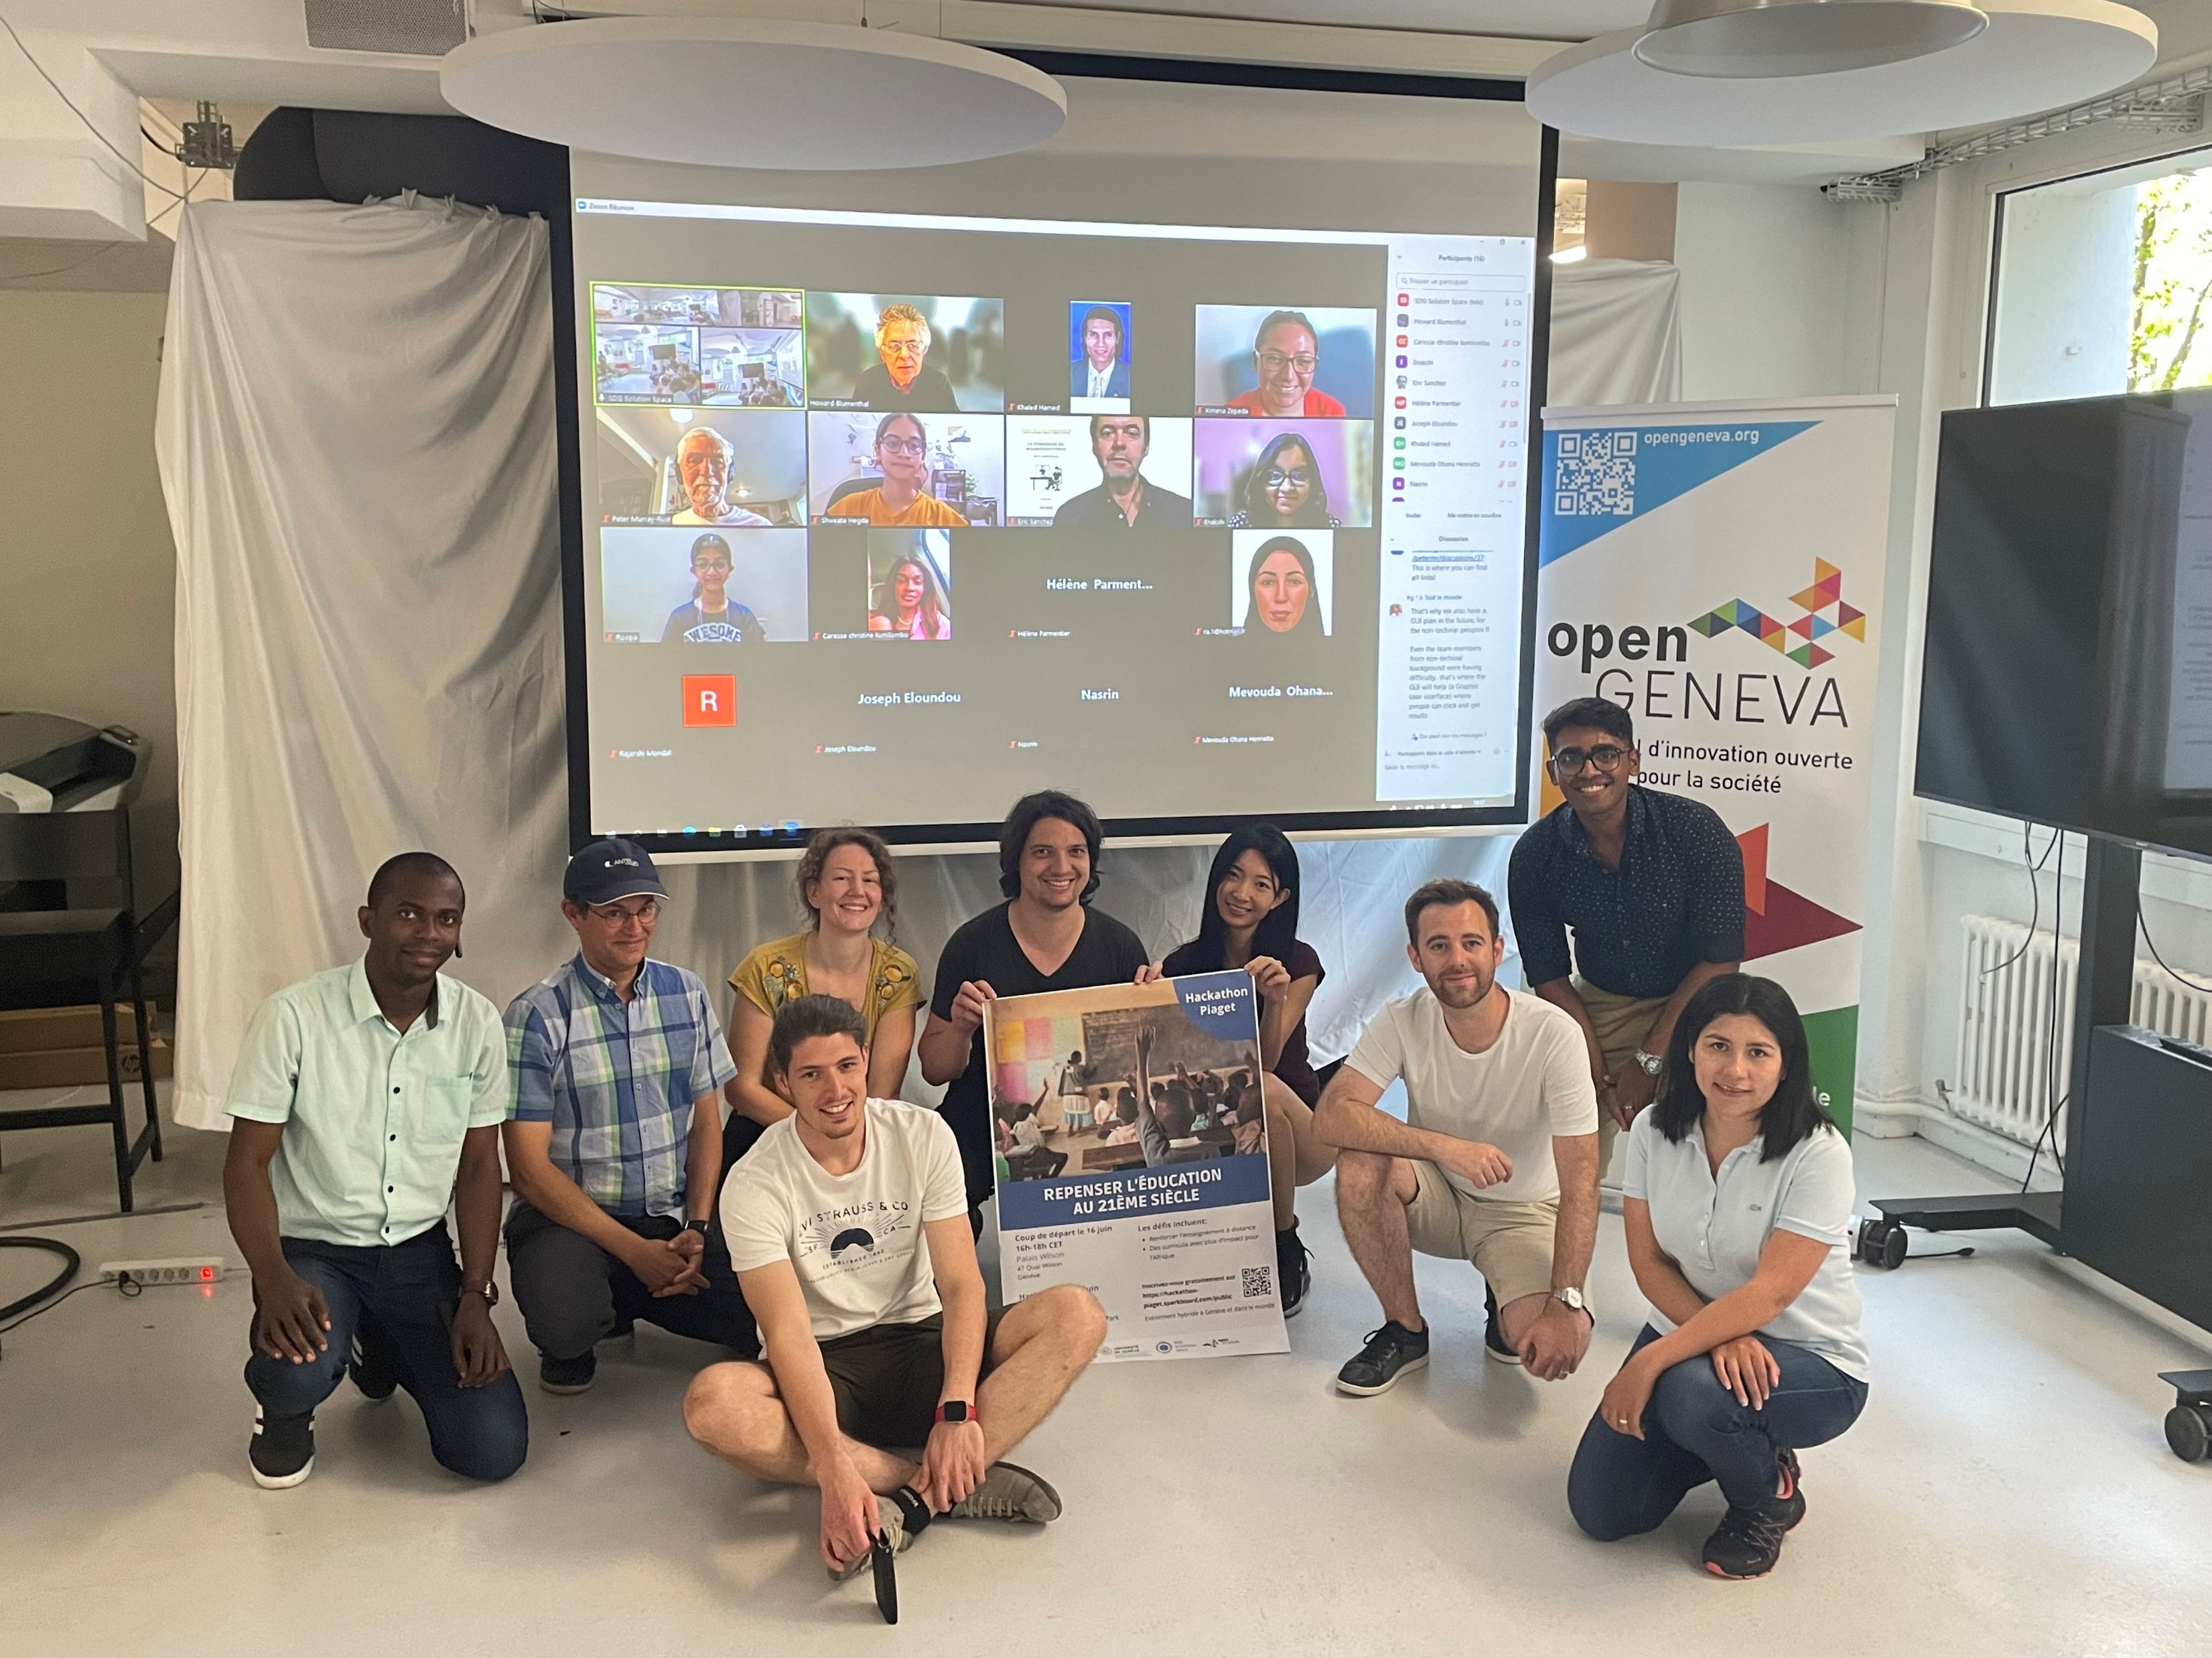
Future
Young people developing tech and collaborations for global challenges
Cambiohack, 2020
Piaget Hackathon, SDG, 2022
Notes:
Traffic Lights -> Spreadsheet + literal traffic light
Daily Stand-ups
What I did
What next
Blockers
Community
Icons > Textual information

Slide 9
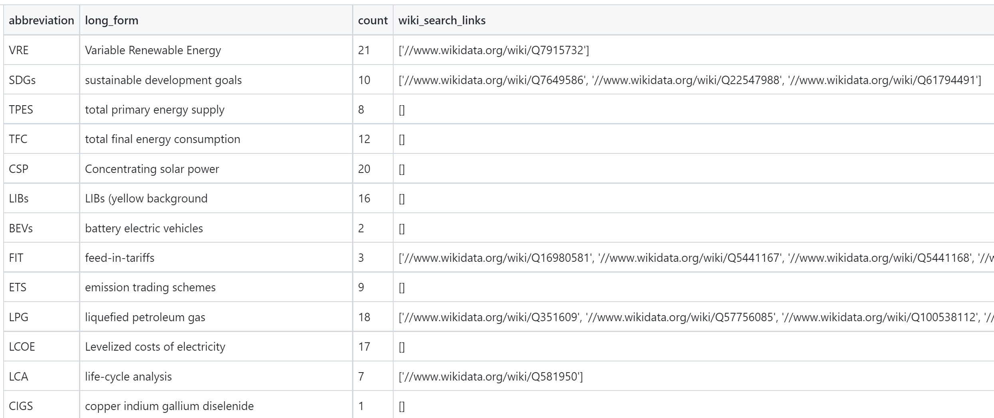
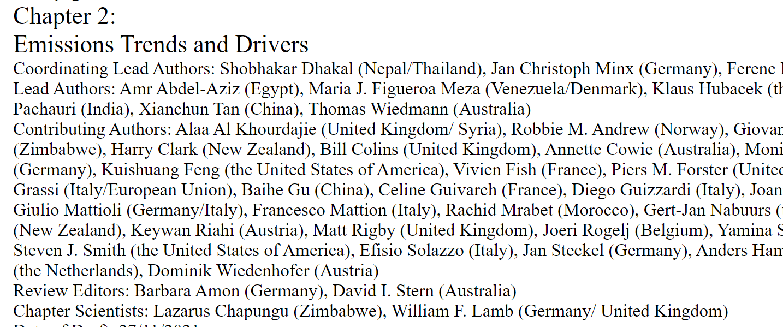
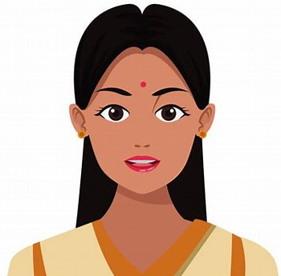
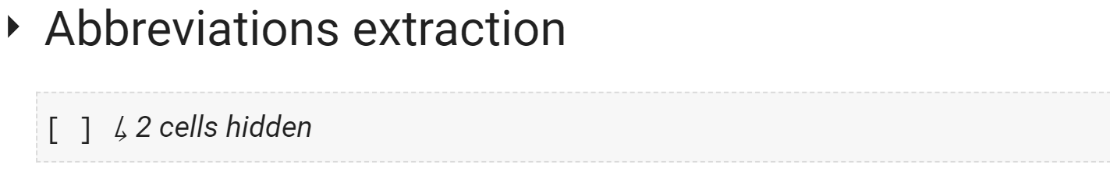

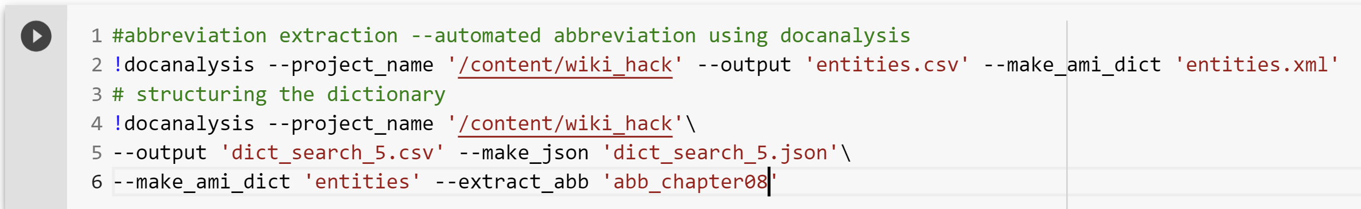
HTML
Abbreviations
Abbreviation 2
docanalysis
Wow!!!
So easy..
Student Authored
Learning Toolkit
Abbreviation 2

Slide 10

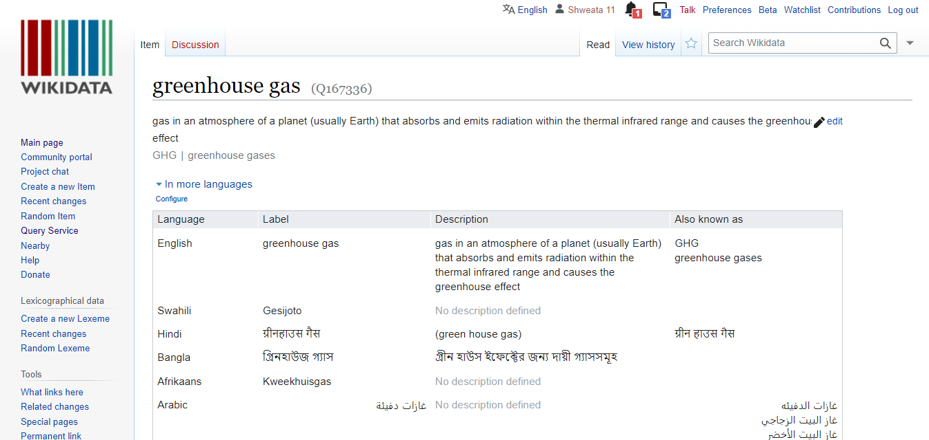
Dictionary
Set of terms with unique Wikidata Identifiers
<entry name="VRE" term="Variable Renewable Energy" wikidataID=“Q7915732”/>
<entry name=“NDC" term=“Nationally Determined Contributions" wikidataID=“Q20051297”/>
<entry name=“GHG" term=“Greenhouse Gas" wikidataID=“Q167336”/>
#SemanticClimate’s Climate Knowledge Hunt
In different languages!

Slide 11


How our TDM tools liberate knowledge
Climate-related terms dictionary
pyami
docanalysis
…despite mitigation efforts 8 including those in near-universal nationally determined contributions (NDCs)…
< >
HTML
#SemanticClimate’s Climate Knowledge Hunt
IPCC chapters,
IPBES reports,
…
Abbreviation dictionary
Automatic open

Slide 12
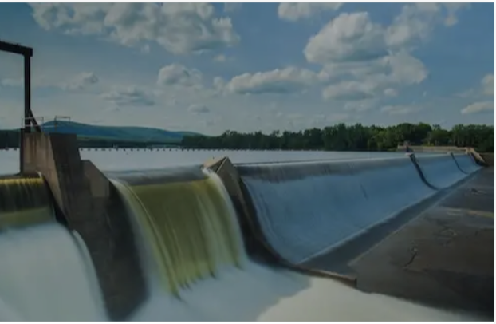
IPCC/~AR6/WG3
Mitigation pathways compatible
with long-term goals
Chapters we are working on
Images of people
Sunag/image
Mitigation pathways compatible
with long-term goals
Sunag/image

Slide 13
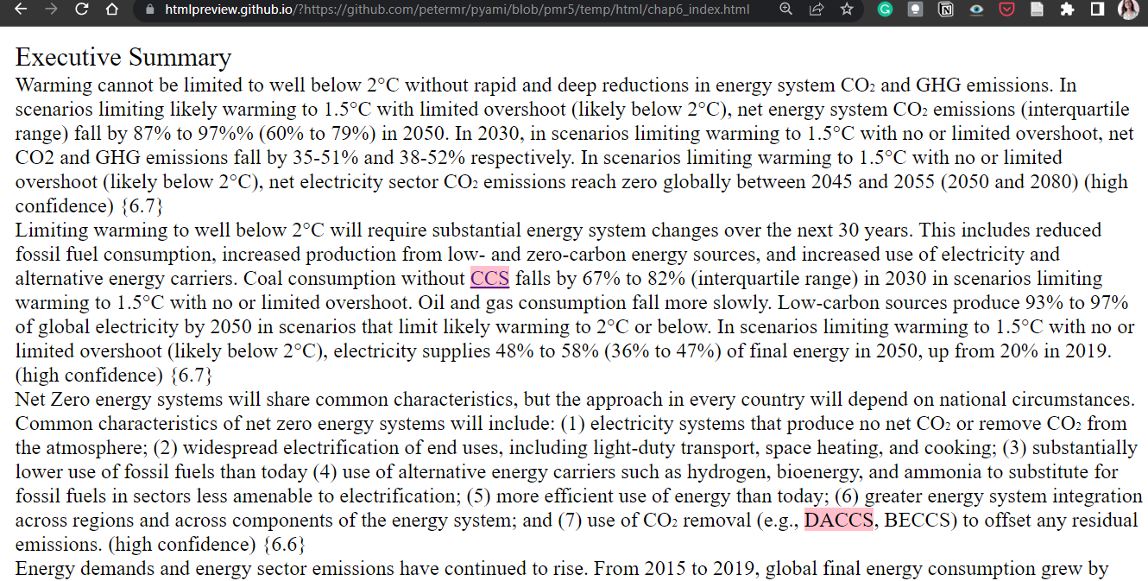
Automatic Indexing with Dictionaries
#SemanticClimate’s Climate Knowledge Hunt
Needs more links larger text

Slide 14
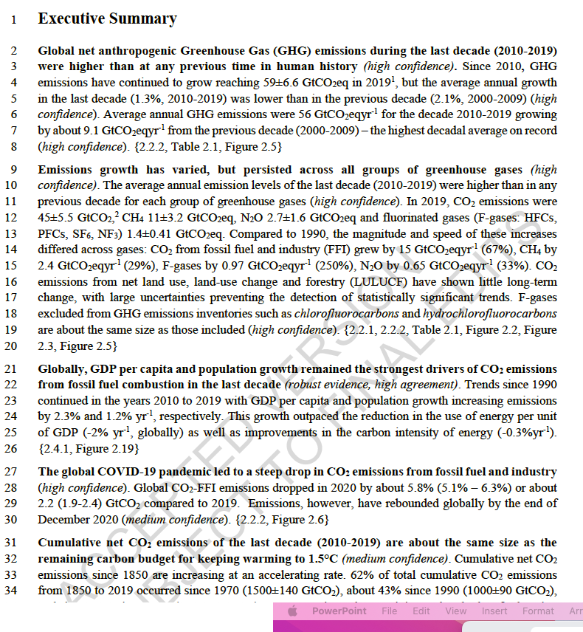
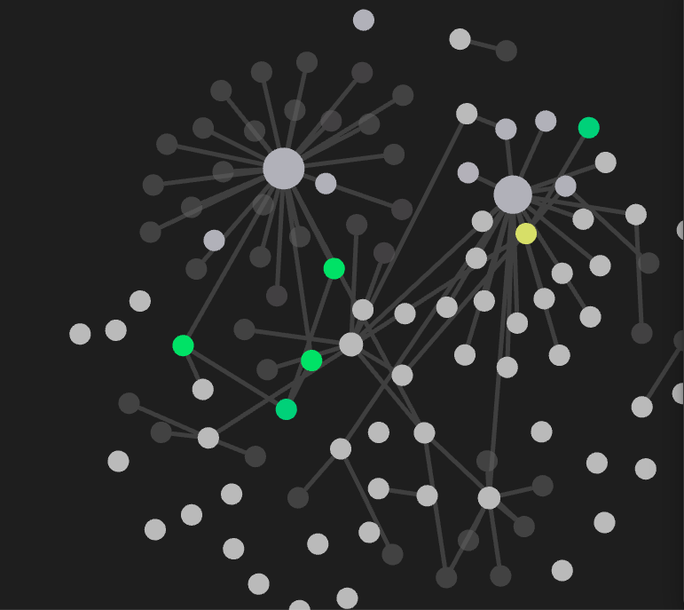
Making IPCC text semantic

Slide 15
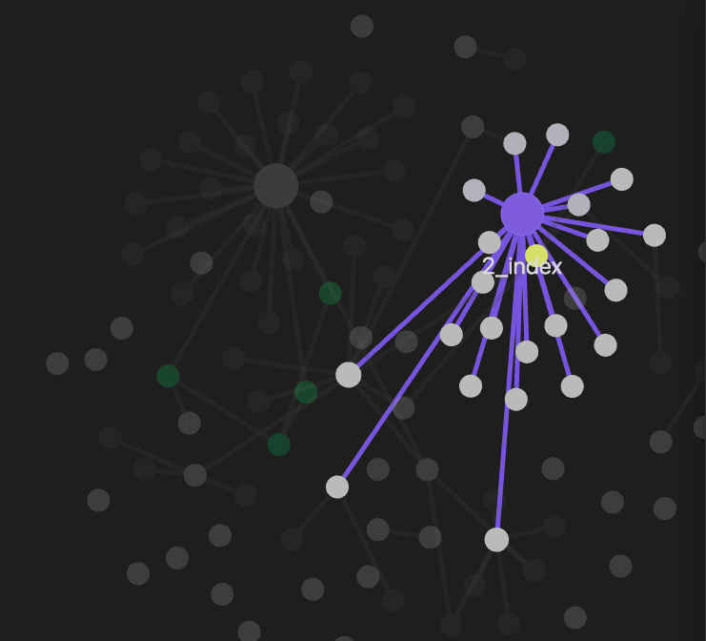
Making IPCC text semantic
Exec_summary_toc
paragraphs

Slide 16
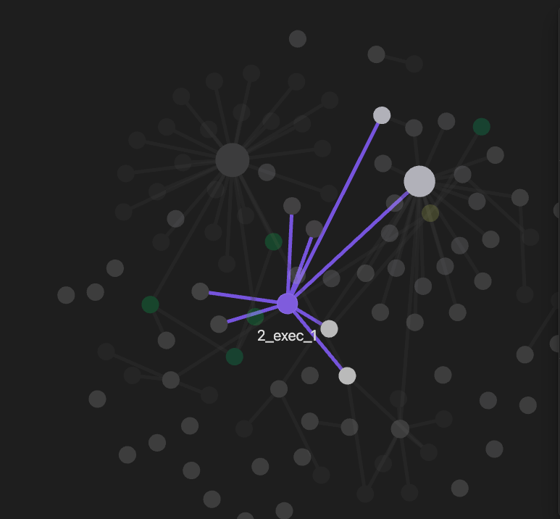
Making IPCC text semantic

Slide 17
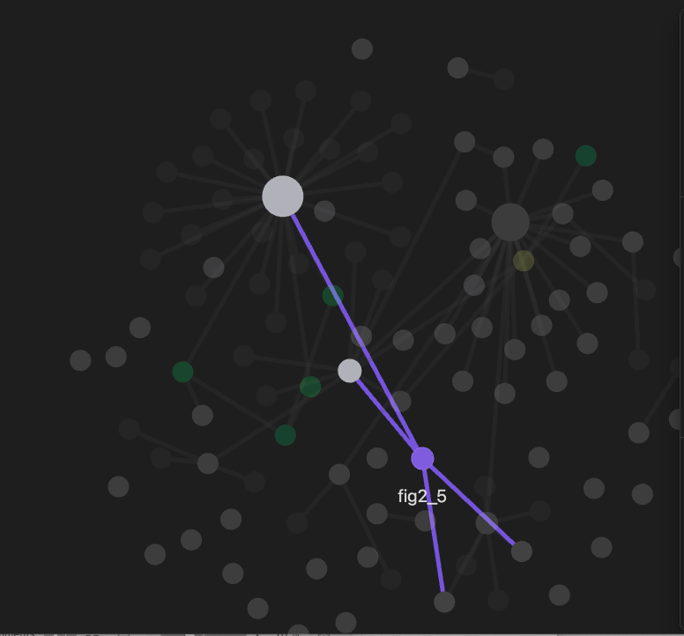
Making IPCC text semantic

Slide 18
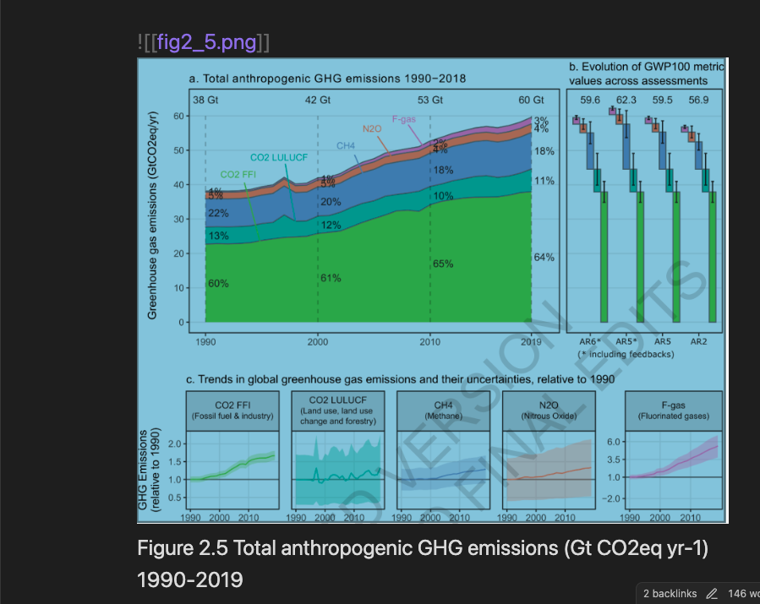
Making IPCC text semantic

Slide 20
Plant Parts Dictionary (CEVOpen)
<entry term="cone“ wikidataURL="http://www.wikidata.org/entity/Q22710" wikidataID="Q22710" wikipediaPage="https://en.wikipedia.org/wiki/Conifer_cone">
<synonym>Cone, Conifer cones, Strobilus, pine cone, pine-cone, pinecone, pine cones</synonym>
<synonym xml:lang="zh">松球</synonym>
<synonym xml:lang="de">Koniferenzapfen</synonym>
<synonym xml:lang="hi">कोणधारी कोण</synonym>
<synonym xml:lang="es">cono</synonym>
<synonym xml:lang="fr">cône</synonym>
<description xml:lang="fr">organe reproducteur des conifères</description>
<description xml:lang="es">estructura vegetal</description>
</entry>
term
Multilingual entries
Credits: Vasant Kumar

